Slide 1
Non-Parametric Models in Machine Learning
Shen Bingquan <sbingqua@dso.org.sg>
National University of Singapore :: School of Engineering :: Engineering Science Programme
Notes:
it won’t change its mind about how many parameters it needs.
When data sets are small
But when there are thousands or millions or billions of examples to learn from, it seems like a better idea to let the data speak for themselves

Slide 2
Non-Parametric Models
Parametric Models: A learning model that summarizes data with a set of parameters of fixed size (independent of the number of training examples).
e.g. neural networks, linear regression (y = mx + c).
Non-Parametric Models: One that cannot be characterized by a bounded set of parameters. Uses all training examples to predict the next example.
Also know as Instance based learning or memory based learning.
Russell, S., & Norvig, P. (2002). Artificial intelligence: a modern approach.
Learning, M. (2012). Tom mitchell. Machine Learning, 10, 601.

Slide 3
Simplest Instance Based Learning Method
Table Lookup
x1 | x2 | y
1.1 | 0.7 | Dog
0.2 | 1.2 | Cat
1.0 | 0.6 | Dog
0.9 | 0.5 | Dog
0.8 | 1.0 | Cat
Query1:
0.2 | 1.2
Output: Cat
Query2:
0.9 | 1.0
Output: ??

Slide 4
Contents
k-Nearest-Neighbours (k-NN)
Data Structures
k-d Trees
Locality Sensitive Hashing
Distance Weighted Nearest Neighbours
Locally Weighted Regression

Slide 5

https://scikit-learn.org/stable/tutorial/machine_learning_map/

Slide 6
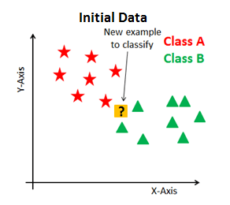
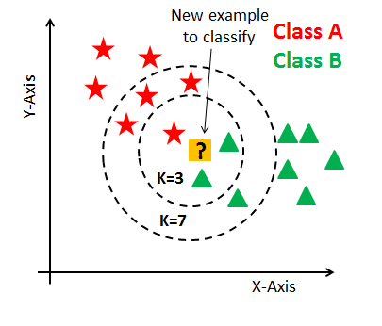
Intuition

Slide 7
What is K-Nearest-Neighbours (k-NN)?
k-NN is a type of instance-based learning that observes what kind of data is lies nearest to the one it’s trying to predict.
It is a lazy learning, where the function is only approximated locally and all computation is deferred until function evaluation.
Advantage of lazy learning is that instead of estimating the target function once for the entire instance space (seen in eager learning), these methods can estimate it locally and differently for each new instance to be classified.
It is a supervised learning method. Given [(x₁,y₁),(x₂,y₂),..., (x_{n},y_{n})]

Slide 8
K-Nearest-Neighbours Algorithm
Learning Algorithm:
Store training examples
Prediction Algorithm:
To classify a new example x by finding the k training examples (x_{i},y_{i}) that is nearest to x
Guess the class y = y_{i}

Slide 9
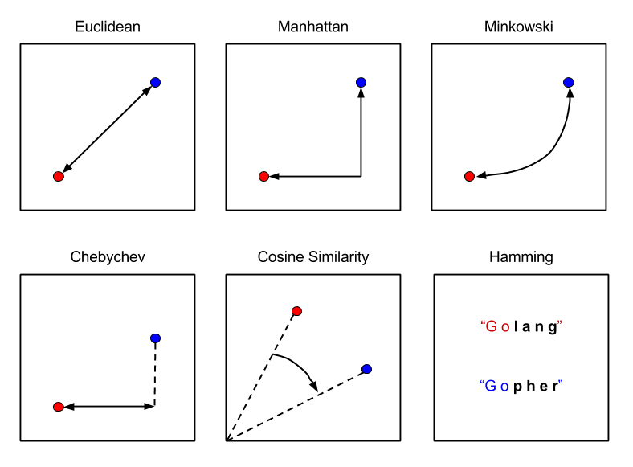
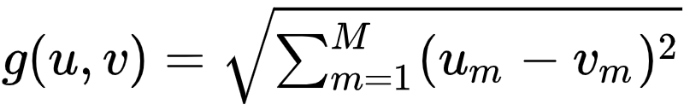

Distance Functions
Euclidean distance
Manhattan distance
Others (e.g. Chebyshev, cosine, hamming)

Slide 10
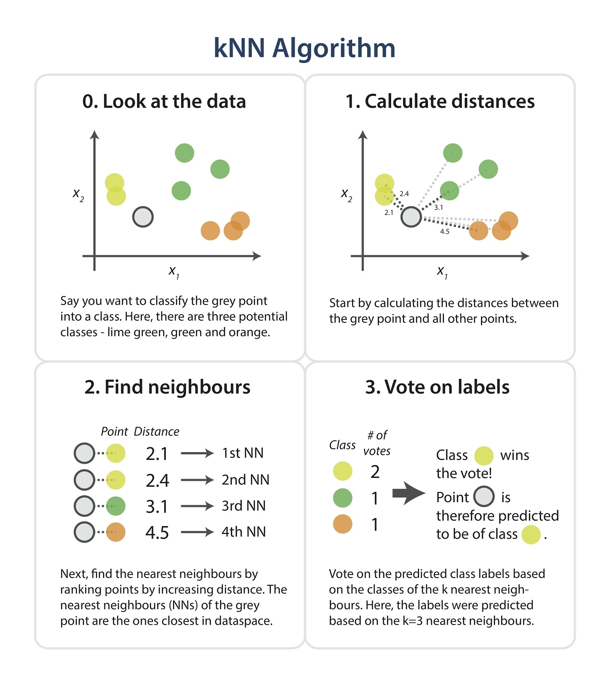

Slide 12

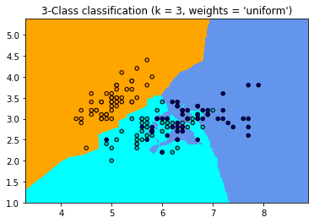
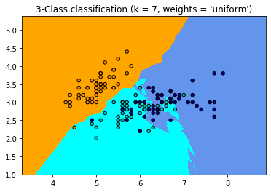
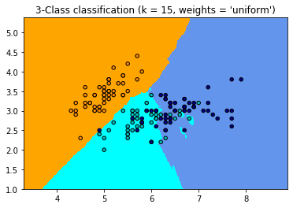
k-NN Decision Boundaries
Iris Dataset (http://archive.ics.uci.edu/ml/datasets/iris)
X: sepal length, sepal width, petal length, petal width
Y: Setosa, Versicolour, Virginica
https://scikit-learn.org/stable/modules/neighbors.html

Slide 13
Curse of Dimensionality
In low-dimensional spaces with plenty of data, nearest neighbors works very well.
But as the number of dimensions rises we encounter a problem: points that are drawn from a probability distribution, tend to never be close together (A lot of free space!)

Slide 14
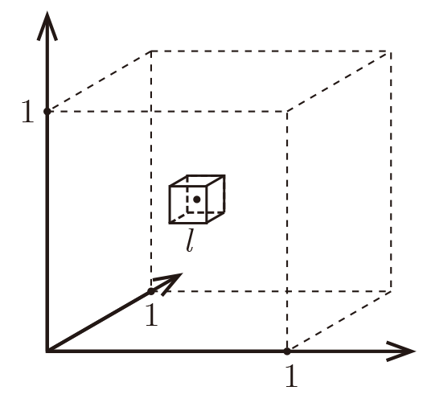
Curse of Dimensionality
Formally, imagine the unit cube [0,1]^{d}. All training data is sampled uniformly within this cube, and we are considering the k=10 nearest neighbors of such a test point.
Let ℓ be the edge length of the smallest hyper-cube that contains all k-nearest neighbor of a test point. Then ℓ^{d} ≈ k / n and ℓ ≈ (k / n)^{1/d.} If
n=1000, how big is ℓ?
https://www.cs.cornell.edu/courses/cs4780/2018fa/lectures/lecturenote02_kNN.html

Slide 15
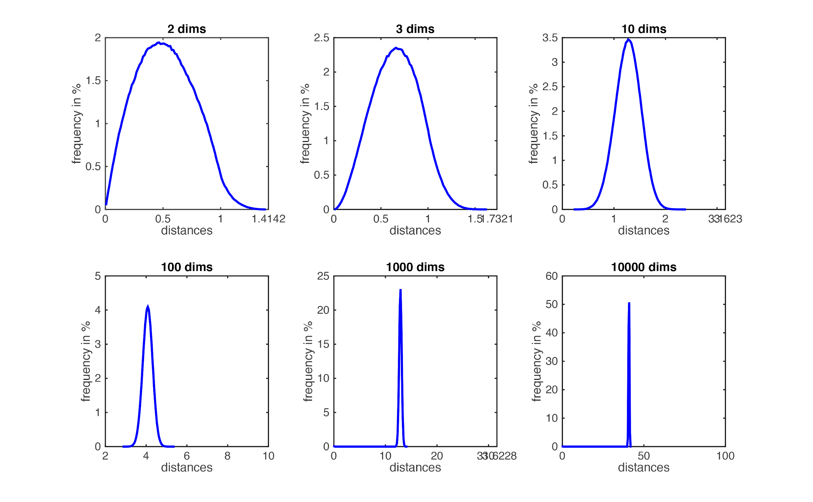
Curse of Dimensionality
So as d≫0 almost the entire space is needed to find the 10-NN.
k-NN assumption breaks down.
d |  | ℓ
2 |  | 0.1
10 |  | 0.63
100 |  | 0.955
1000 |  | 0.9954
Soup bubble gaussians - https://www.inference.vc/high-dimensional-gaussian-distributions-are-soap-bubble/

Slide 16
Computational Complexity
How to find those nearest neighbours?
Naive Approach: Given a set of N examples and a query x_{q}, iterate through the examples, measure the distance to x_{q} from each one, and keep the best k.
O(N)
Binary Tree: O(logN)
Hash table: O(1)

Slide 17
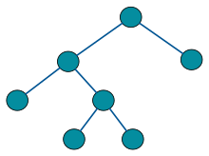
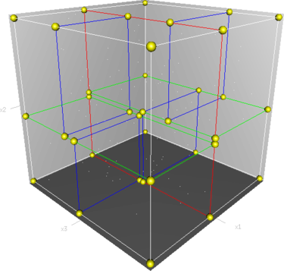
Finding NN with k-d Trees (k-dimensional tree)
A binary search tree where data in each node is a k-dimensional point in space. In short, it is a space partitioning data structure for organizing points in a k-dimensional space.
A binary tree is a tree data structure in which each node has at most two children.
Root node

Slide 18
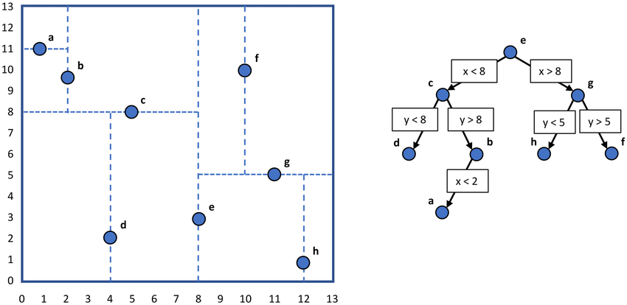
K-d Tree Data Structure
Bisecting structure
Each branch point is the median in some dimension
One set of descendants are to one side, and one to the other
Cycle the dimensions

Slide 19
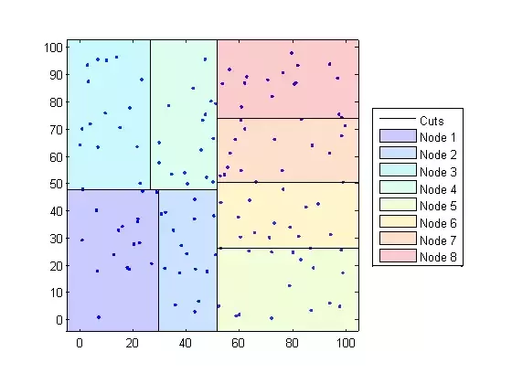
K-d Tree Data Construction
Pick random dimension
Find median (expensive O(N) or O(N log N))
Split data
Repeat
Search Region

Slide 20
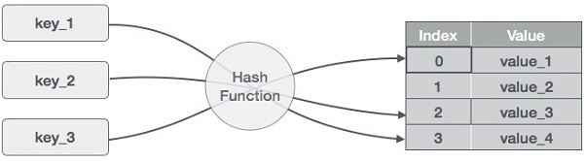
Locality Sensitive Hashing
A hash table (hash map) is a data structure that implements an associative array abstract data type, a structure that can map keys to values.
How can we find nearest neighbors using a hash table, when hash codes rely on an exact match?
Locality Sensitive Hashing

Slide 21
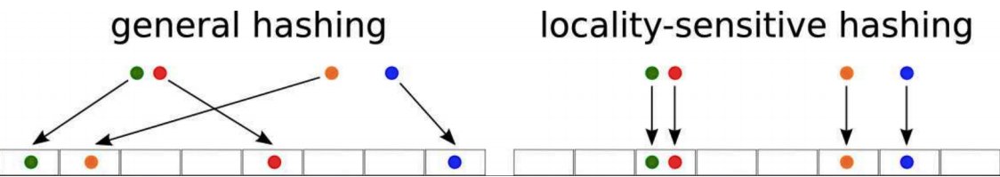
Locality Sensitive Hashing
We can’t use hashes to solve NN exactly, but with a clever use of randomized algorithms, we can find an approximate solution.
Hash collisions are maximized, not minimized.
Desired hash function property for any two points, the probability that they have the same hash code is small if their distance is more than cr, and is high if their distance is less than r.

Slide 22
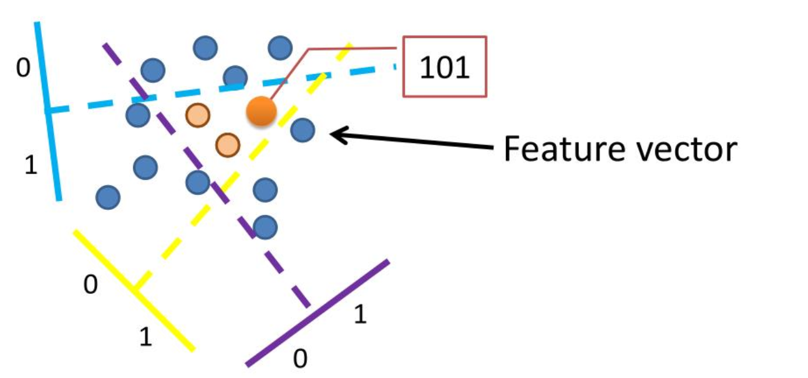
Locality Sensitive Hashing
Create multiple random projections of data r^{T}x
Quantize each projection with few bits
Hash Key
https://www.mit.edu/~andoni/LSH/

Slide 23
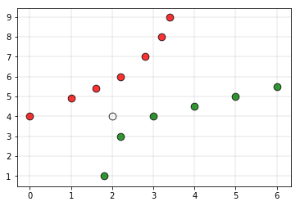
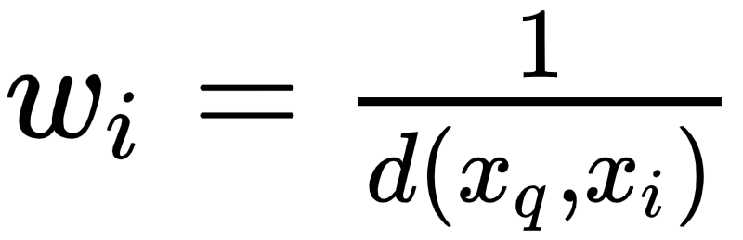
Distance Weighted Nearest Neighbours
Distance weighted k-NN is a modified version of the original k-NN
Give more weight to the points which are nearby and less weight to the points which are farther away.
https://www.geeksforgeeks.org/weighted-k-nn/

Slide 24
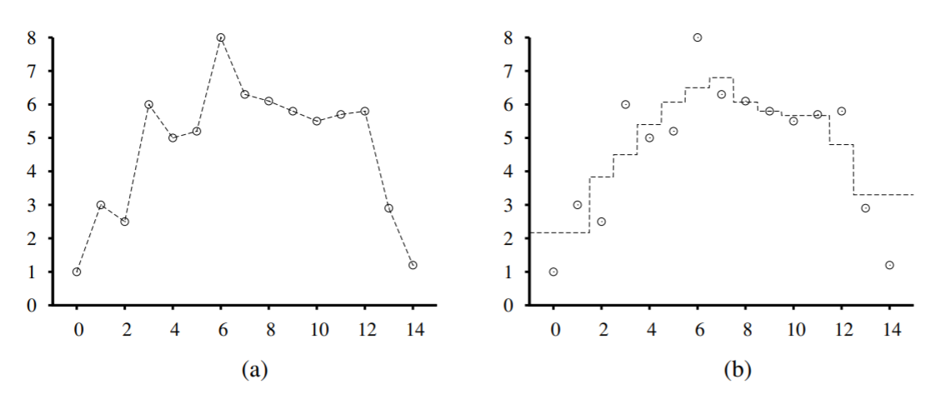
Locally Weighted Regression
The k-NN can be thought of as approximating the target function f(x) at the single query point x = x_{q}. Locally weighted regression is a generalization of this approach. It constructs an explicit approximation to f over a local region surrounding x_{q}.
Connect the dots
3-NN Average

Slide 25
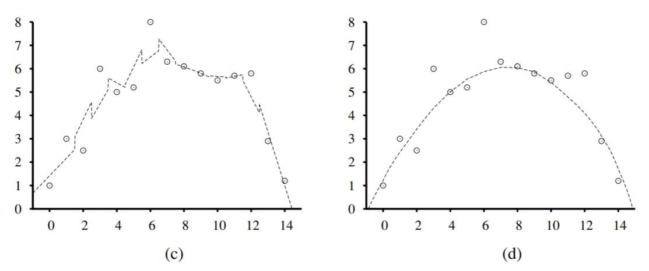
Locally Weighted Regression
3-NN Linear Regression
Locally Weighted Regression
(with a quadratic kernel of width k = 10)

Slide 26
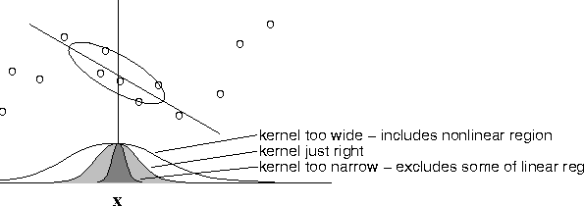
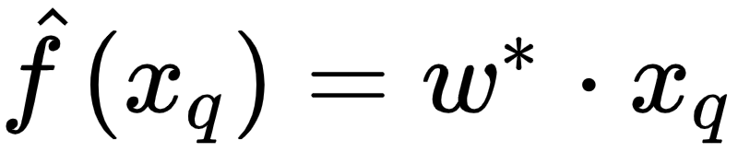
Locally Weighted Regression
Solve weighted regression problem (using gradient descent):
Prediction:
Note: Need to solve a new regression problem for every query point, since local.

Slide 27
Summary
k-Nearest-Neighbours (k-NN)
Data Structures
k-d Trees
Locality Sensitive Hashing
Distance Weighted Nearest Neighbours
Locally Weighted Regression

Slide 28
References
http://www.cs.cmu.edu/~mgormley/courses/10601/slides/lecture5-ms.pdf
http://people.csail.mit.edu/dsontag/courses/ml12/slides/lecture10.pdf
https://www.cs.cornell.edu/courses/cs4780/2018fa/lectures/lecturenote02_kNN.html
https://www.slideserve.com/teneil/locality-sensitive-hashing-and-large-scale-image-search
https://www.cs.cmu.edu/afs/cs/project/jair/pub/volume4/cohn96a-html/node7.html

